Slide 1



Music Store Data Analysis
The store want to increase their sale. So we need to solve several queries using SQL to help in their business growth.
We have total 11 tables :
Artist
Album
Playlist
PlaylistTrack
Track
MediaType
Genre
InvoiceLine
Employee
Customer
Invoice

Slide 2
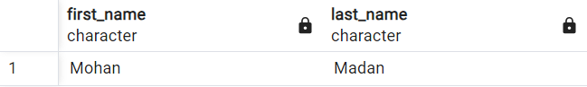

Who is the senior most employee based on the job title?
select first_name,last_name from employee
order by levels desc
Limit 1

Slide 3
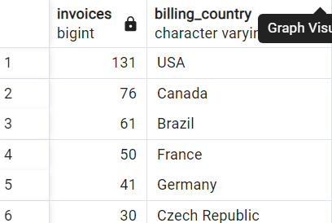
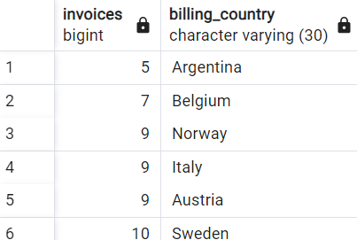
Which countries have the most Invoices and Least invoices?
select count(*) as invoices,billing_country
from invoice
group by billing_country
order by invoices desc
select count(*) as invoices,billing_country
from invoice
group by billing_country
order by invoices

Slide 4
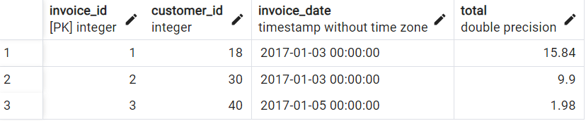
What are top 3 values of total invoice?
select invoice_id,customer_id,invoice_date,total
from invoice
limit 3

Slide 5
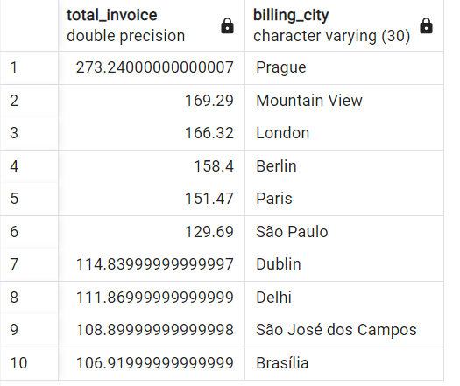
Which city has the best customers? We would like to throw a promotional Music Festival in the city we made the most money. Write a query that returns one city that has the highest sum of invoice totals. Return both the city name & sum of all invoice totals
select sum(total)as total_invoice,billing_city
from invoice
group by billing_city
order by total_invoice desc
limit 10

Slide 6
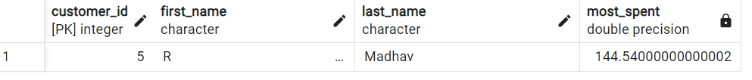
Who is the best customer? The customer who has spent the most money will be declared the best customer. Write a query that returns the person who has spent the most money.
select customer.customer_id,customer.first_name,customer.last_name, sum(invoice.total)as most_spent
from customer
left join invoice
on customer.customer_id=invoice.customer_id
group by customer.customer_id
order by most_spent desc
limit 1

Slide 7
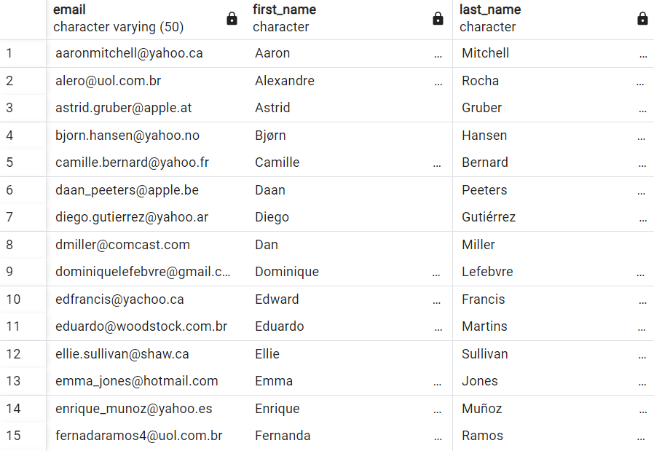
Write query to return the email, first name, last name, & Genre of all Rock Music listeners. Return your list ordered alphabetically by email starting with A.
select distinct email,first_name,last_name
from customer
join invoice on customer.customer_id=invoice.customer_id
join invoice_line on invoice.invoice_id=invoice_line.invoice_id
where track_id in(
select track_id from track
join genre on track.genre_id=genre.genre_id
where genre.name like 'Rock’)
order by email;

Slide 8
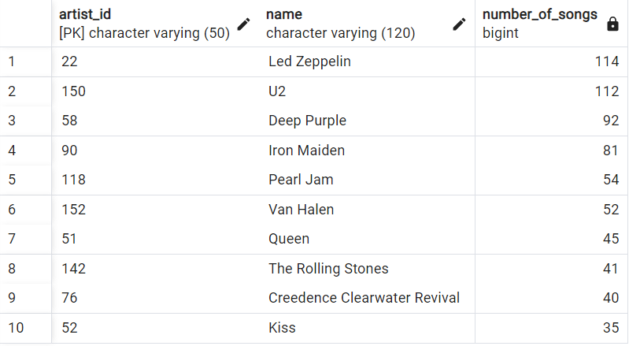
Let's invite the artists who have written the most rock music in our dataset. Write a query that returns the Artist name and total track count of the top 10 rock bands.
SELECT artist.artist_id, artist.name,COUNT(artist.artist_id) AS number_of_songs
FROM track
JOIN album ON album.album_id = track.album_id
JOIN artist ON artist.artist_id = album.artist_id
JOIN genre ON genre.genre_id = track.genre_id
WHERE genre.name LIKE 'Rock’
GROUP BY artist.artist_id
ORDER BY number_of_songs DESC
LIMIT 10;

Slide 9
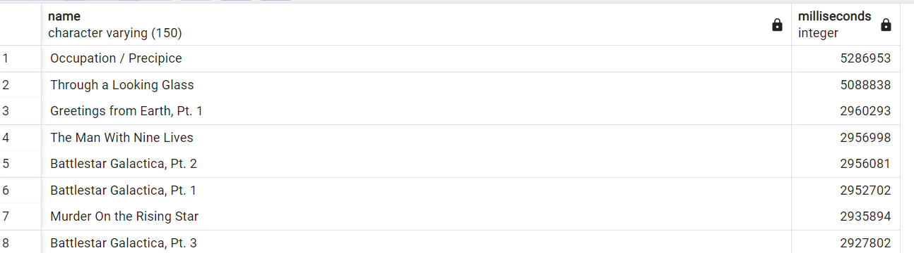
Return all the track names that have a song length longer than the average song length. Return the Name and Milliseconds for each track. Order by the song length with the longest songs listed first.
SELECT name,milliseconds
FROM track
WHERE milliseconds > (
SELECT AVG(milliseconds) AS avg_track_length
FROM track )
ORDER BY milliseconds DESC;

Slide 10
Find how much amount spent by each customer on artists? Write a query to return customer name, artist name and total spent
WITH best_selling_artist AS (
SELECT artist.artist_id AS artist_id, artist.name AS artist_name, SUM(invoice_line.unit_price*invoice_line.quantity) AS total_sales
FROM invoice_line
JOIN track ON track.track_id = invoice_line.track_id
JOIN album ON album.album_id = track.album_id
JOIN artist ON artist.artist_id = album.artist_id
GROUP BY 1
ORDER BY 3 DESC
LIMIT 1
)
SELECT c.customer_id, c.first_name, c.last_name, bsa.artist_name, SUM(il.unit_price*il.quantity) AS amount_spent
FROM invoice i
JOIN customer c ON c.customer_id = i.customer_id
JOIN invoice_line il ON il.invoice_id = i.invoice_id
JOIN track t ON t.track_id = il.track_id
JOIN album alb ON alb.album_id = t.album_id
JOIN best_selling_artist bsa ON bsa.artist_id = alb.artist_id
GROUP BY 1,2,3,4
ORDER BY 5 DESC;

Slide 11
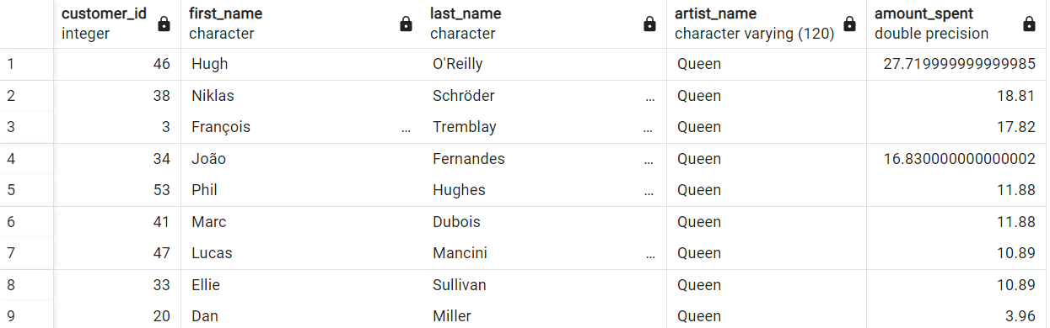
Find how much amount spent by each customer on artists? Write a query to return customer name, artist name and total spent

Slide 12
We want to find out the most popular music Genre for each country. We determine the most popular genre as the genre with the highest amount of purchases. Write a query that returns each country along with the top Genre. For countries where the maximum number of purchases is shared return all Genres.
WITH RECURSIVE
sales_per_country AS(
SELECT COUNT(*) AS purchases_per_genre, customer.country, genre.name, genre.genre_id
FROM invoice_line
JOIN invoice ON invoice.invoice_id = invoice_line.invoice_id
JOIN customer ON customer.customer_id = invoice.customer_id
JOIN track ON track.track_id = invoice_line.track_id
JOIN genre ON genre.genre_id = track.genre_id
GROUP BY 2,3,4
ORDER BY 2
),
max_genre_per_country AS (SELECT MAX(purchases_per_genre) AS max_genre_number, country
FROM sales_per_country
GROUP BY 2
ORDER BY 2)
SELECT sales_per_country.*
FROM sales_per_country
JOIN max_genre_per_country ON sales_per_country.country = max_genre_per_country.country
WHERE sales_per_country.purchases_per_genre = max_genre_per_country.max_genre_number;

Slide 13
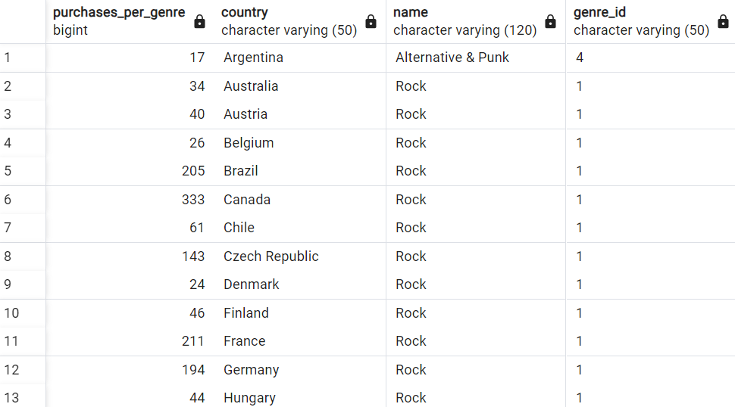
We want to find out the most popular music Genre for each country. We determine the most popular genre as the genre with the highest amount of purchases. Write a query that returns each country along with the top Genre. For countries where the maximum number of purchases is shared return all Genres.

Slide 14
Write a query that determines the customer that has spent the most on music for each country. Write a query that returns the country along with the top customer and how much they spent. For countries where the top amount spent is shared, provide all customers who spent this amount.
WITH Customter_with_country AS (
SELECT customer.customer_id,first_name,last_name,billing_country,SUM(total) AS total_spending,
ROW_NUMBER() OVER(PARTITION BY billing_country ORDER BY SUM(total) DESC) AS RowNo
FROM invoice
JOIN customer ON customer.customer_id = invoice.customer_id
GROUP BY 1,2,3,4
ORDER BY 4 ASC,5 DESC)
SELECT * FROM Customter_with_country WHERE RowNo <= 1
/* Method 2: Using Recursive */
WITH RECURSIVE
customter_with_country AS (
SELECT customer.customer_id,first_name,last_name,billing_country,SUM(total) AS total_spending
FROM invoice
JOIN customer ON customer.customer_id = invoice.customer_id
GROUP BY 1,2,3,4
ORDER BY 2,3 DESC),
country_max_spending AS(
SELECT billing_country,MAX(total_spending) AS max_spending
FROM customter_with_country
GROUP BY billing_country)
SELECT cc.billing_country, cc.total_spending, cc.first_name, cc.last_name, cc.customer_id
FROM customter_with_country cc
JOIN country_max_spending ms
ON cc.billing_country = ms.billing_country
WHERE cc.total_spending = ms.max_spending
ORDER BY 1;

Slide 15
We want to find out the most popular music Genre for each country. We determine the most popular genre as the genre with the highest amount of purchases. Write a query that returns each country along with the top Genre. For countries where the maximum number of purchases is shared return all Genres.

Slide 16
Music Store Data Analysis
The store want to increase their sale. So we need to solve several queries using SQL to help in their business growth.
We have total 11 tables :
Artist
Album
Playlist
PlaylistTrack
Track
MediaType
Genre
InvoiceLine
Employee
Customer
Invoice

